Slide 1

Global Ties, Local Strategies Tips & Traps - Planning for Clients with International Connections
Joan K. Crain, CFP®, TEP, AEP® (distinguished)
Global Wealth Advisor
J Crain Consulting
October 20, 2025

Slide 2
AGENDA
Trap 1: Reality check: look before you leap
Foreign taxes, legal systems, investments…and other surprises
Trap 2: The non-citizen spouse: what – no marital deduction?!
Trap 3: The child living abroad: a problem beneficiary?
Trap 4: Onshoring a foreign retirement account…or not
Trap 5: Critical deadlines you don’t want to miss
Trap 6: Domicile Planning
Trap 7: Foreign trusts, especially the “grantor” kind!
Trap 8: Change!

Slide 3
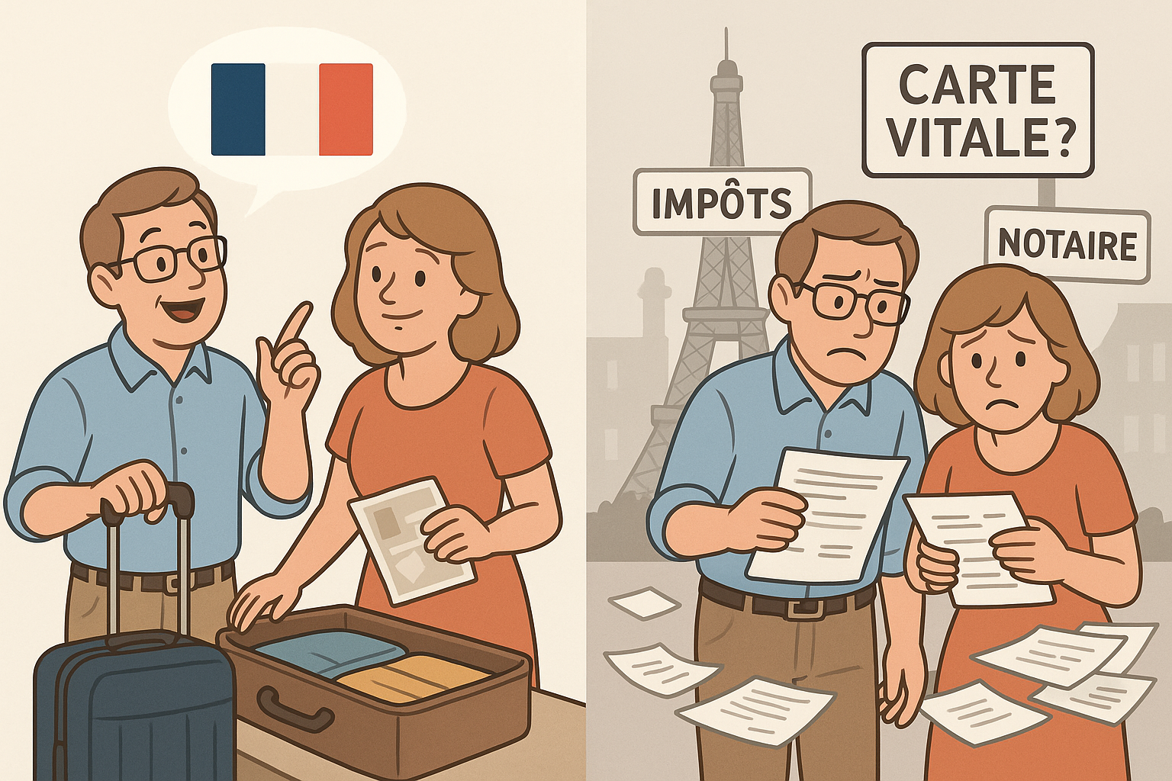
Trap #1: Moving Abroad: Look Before You Leap Prepare for surprises and complications!

Slide 4

Trap #1: Moving Abroad: Look Before You Leap Expatriation vs Living ex-U.S.
“Rosie O’Donnell made good on her promise to leave America”
NY Times 04/18/2025
She is reported to be applying for Irish citizenship
But is she expatriating?

Slide 5
Trap #1: Moving Abroad: Look Before You Leap Plan Ahead for foreign taxes, legal docs and culture!
Confusion: expatriation vs “living abroad”
The residence: rent or buy?
Planning for taxes: foreign & U.S.
Investing as a non-U.S. resident
New estate planning documents?

Slide 6

Trap #1: Moving Abroad: Look Before You Leap New Estate Planning Documents?
Health care documents
Living Wills and equivalents
Health Care Powers of Attorney and equivalents
Power of Attorney
Will(s)
Situs Wills?
What to do with trusts?

Slide 7
Trap #2: The Non-Citizen Spouse (NCS) Critical but often overlooked question for new clients
“Are you and your spouse both U.S. CITIZENS?”
If “No”
No estate tax marital deduction
No unlimited lifetime annual exclusion
No allocation of jointly owned assets when U.S. spouse predeceases

Slide 8
Trap #2: The Non-Citizen Spouse (NCS) Planning ahead to mitigate taxes
Annual exclusion gifts to NCS up to $190,000/year
Loans to NCS so they can contribute to jointly owned assets
Monitor purchases of jointly owned assets so NCS can contribute
Use some or all of U.S. spouse’s estate tax exemption f/b/o NCS
Irrevocable Life Insurance Trust with NCS as beneficiary
Testamentary Qualified Domestic Trust (QDOT)

Slide 9
Trap #2: The Non-Citizen Spouse (NCS) Qualified Domestic Trust
Testamentary only (no inter vivos)
Must have at least one U.S. trustee
If >$2 million, must have U.S. corporate trustee or post bond
Mandatory income to surviving spouse
Access to principal very limited; taxed at decedent spouse’s highest marginal estate tax
Remainder taxed as if part of decedent spouse’s estate

Slide 10
Trap #2: The Non-Citizen Spouse (NCS) Post Mortem Options
Disclaimer
Could be full or partial disclaimer
Must be done prior to filing deceased spouse’s estate tax return
Become a U.S. citizen
To avoid tax or QDOT, must remain in U.S. until citizenship is granted
Timing could be challenging if this process only began post-death

Slide 11

Trap #3: The Child Who Lives in Portugal Planning for family members living abroad
“Do you have any family members living outside the U.S.?”
If “Yes”, considerations when making gifts and bequests
Gifts of securities may clash with rules for U.S. persons abroad
IRA beneficiary designations may be counter-productive
Trusts may not work well in another jurisdiction – at a minimum, beneficiary will have reporting obligations

Slide 12
Trap #3: Family Who Live Abroad Beware of Trusts!
Even in other common law jurisdictions trust law and taxes can vary significantly vs. U.S.
Canada: “deemed resident” trusts; 21-year deemed sale = capital gains tax
U.K.: 10-year “periodic charge” = tax on assets
Civil law countries are often even less favorable to trusts
May ignore the trust and tax beneficiaries directly
E.g., France: One French resident beneficiary pulls entire trust into French tax and reporting obligations = privacy as well as financial implications

Slide 13
Trap #4: The Foreign Retirement Account Tax-deferred retirement accounts do not travel well
New country rarely recognizes or coordinates tax benefits with originating country
Exception: Social Security totalization agreements
Hint: if U.S. person moves abroad consider suspending further contributions to U.S. retirement accounts
Avoid complex mismatched taxes
But may be difficult to maintain accounts in U.S. if no U.S. home address

Slide 14
Trap #4: The Foreign Retirement Account Tax-deferred retirement accounts do not travel well
U.S. rarely recognizes tax deferral of non-U.S. retirement accounts
U.S. person returning from living abroad faces difficult choice re: their foreign retirement account
Two options
1. Leave account abroad, no further additions, withdraw per foreign country’s rules
OR
2. Liquidate foreign account, bring funds to U.S., maybe start new U.S. retirement account

Slide 15

Trap #5: Missing Critical Deadlines Even investor visas must be renewed
Back from holidays…but the E-2 deadline was yesterday!

Slide 16
Trap #5: Missing Critical Deadlines No do-overs on these
Visa renewals
Student visas, H-1B, E-2, EB-5, etc
Expatriation “window”
Green cards for <8/15 years may not be “covered expatriates”
Reporting foreign connections
Foreign gifts (3520)
Foreign trust activity (3520, 3520A)
Foreign assets and accounts; including signing authority (FBAR, 8938, etc)

Slide 17
Trap #6: Domicile Missing creative planning opportunities
Domicile
*
* Estate Tax
* US Citizens + Some Others
*Place to return to
* Subjective, Based on Intent
Residence
* Income Tax
* US Citizens, LTRs, ++
*183 day formula and other options
* Bright line test

Slide 18

Creative Domicile Planning Example: Mme Leblanc of France
Mme Leblanc is a French citizen (non-U.S.) living in U.S.
E-2 investment visa based on her perfume import business
15 years in U.S.; unsure if she will return to France to live
Retains ancestral home in Brittany; frequently visits
Age 55; unmarried; 2 children (both U.S.)
Net worth $20MM
Including $12MM in a BVI company
Is Mme Leblanc a U.S. domiciliary?

Slide 19
Creative Domicile Planning Example: Mme Leblanc
Why is domicile important?
Advantages to U.S. Domicile
Full FET exemption
Testamentary freedom; no forced heirship
Disadvantages to U.S. Domicile
U.S. estate tax on excess >exemption; including offshore company
France may assert French domicile; treaty tie-breaker rules may not be definitive; long costly settlement by competent authorities

Slide 20
Creative Domicile Planning Example: Mme Leblanc
U.S.-France Estate & Gift Tax Treaty:
Article 4 (Domicile) = Domicile Tie-Breakers in sequence
Permanent Home in only one country
Center of Vital Interests: personal & economic
Habitual Abode: most frequent residence
Nationality: a citizen of only one country
Competent Authorities/Mutual Agreement

Slide 21
Creative Domicile Planning Example: Is Mme Leblanc a U.S. Domiciliary?
Yes, she is a U.S. Domiciliary
Closest family is in U.S.: 2 children, grandchildren
Business, current home (luxury condo) in Miami
15+ years with U.S. as primary residence
Only visits France periodically for vacations
No, she is a French Domiciliary
Ancestral home in Brittany owned in personal name
Frequent trips to France; spends a month at a time in Brittany
Friends and business partners in France
She is a French citizen and is in the U.S. on a non-immigrant visa
Conclusion: Arguments support both positions! Flexibility is key!

Slide 22
Trap #7: Foreign Trusts Surprises in U.S. statutes
The “rev trust” that transforms into a foreign trust
U.S. grantor is initial trustee = U.S. trust
U.S. grantor dies; successor trustee is foreign national living abroad = foreign trust
If a foreign country has jurisdiction over the current trustee, the trust fails the control test

Slide 23
Trap #7: Foreign Trusts Surprise – It’s now a Foreign Non-Grantor Trust!
U.S. Revocable Living Trust
U.S. Grantor
U.S. Trustee
Death of U.S. Grantor/Trustee
Non-U.S. Successor Trustee
U.S. Beneficiaries
U.S. Beneficiary
Foreign Non-Grantor Trust
Capital Gains Tax
Reporting by U.S. Beneficiaries
Harsh tax regime for U.S. beneficiaries

Slide 24
Trap #7: Foreign Trusts Query – Is this now a Foreign Grantor Trust?!
U.S. Revocable Living Trust
U.S. Grantor
U.S. Trustee
U.S. Grantor/Trustee
Moves Abroad
Trustee is U.S. citizen but not U.S. Resident
U.S. Beneficiary
Foreign?? Grantor Trust
Where is the trust “administered”?
Where are the assets?
U.S. Court’s role?

Slide 25
Trap #7: Foreign Trusts Surprises in U.S. statutes
The foreign trust that is considered a grantor trust
U.S. settlor
Current beneficiaries are non-U.S.
But future beneficiaries could be U.S.
No prohibition on U.S. beneficiaries
Trust is considered a foreign grantor trust
Grantor pays income tax on trust’s income

Slide 26
Trap #7: Foreign Trusts Surprise – It’s a Foreign Grantor Trust! * U.S. Settlor creates a foreign trust * Foreign trust has or may have U.S. beneficiaries * Trust is considered a Foreign Grantor Trust * U.S. Settlor pays trust’s income tax
Foreign Grantor Trust
U.S. Settlor
Non-U.S. Beneficiaries
Future Benes = U.S.?
Foreign Trust

Slide 27

Trap #8: What’s New in the Red, White & Blue? Fast Changing Laws, Tools and Rhetoric
OBBBA!
Section 899 – much ado about nothing?
Section 4475 – Remittance Transfer Excise Tax
Reporting: on-again, off-again: BOIR, BE-10…and foreign equivalents
Double Taxation or FTC offset for NIIT?
Gold Card: expedited immigration visa (trumpcard.gov)
Platinum Card: preferential taxation?
AI!

Slide 28

Trap #8: What’s New in the Red, White & Blue? Fast Changing Laws, Tools and Rhetoric
Artificial Intelligence!!

Slide 29
Questions?

